Slide 1

AI JOURNAL WITH SENTIMENT ANALYSIS
SPRINT 3
15 May, 2026
Notes:
we still need to choose a logo and replace it with the one here

Slide 2
AGENDA OVERVIEW
01
06
TEAM MEMBER ROLES AND RESPONSIBILITIES
MVP
02
07
IMPROVEMENTS MADE FROM FEEDBACK
TECHNOLOGIES
03
08
PROJECT DESCRIPTION
ALGORITHMS
04
09
TEAM WORKING AGREEMENT
DIAGRAMS
05
10
USER PERSONAS
SPRINT 2 RECAP

Slide 3
AGENDA OVERVIEW CONTD.
11
16
PRODUCT BACKLOG
RETROSPECTIVE
12
17
SPRINT 1 SUMMARY
PROJECT DEMO
13
18
SPRINT 2 SUMMARY
GITHUB
14
19
SPRINT 3 BACKLOG
LIVE APP DEMO
15
20
METRICS
TEAM NEXUS

Slide 4






TEAM MEMBERS
KRISHNA
CHINTAN KOTADIYA
RAFAELA HOLLANDA
Scrum Master | Developer
Developer | Tester
Team Leader | Developer
VANESSA AGBUGBA
SANKET MATROJA
SAI
Front End Developer
AI Generalist
Developer
Notes:
Are we including Professor Wong like he asked? I did it in case, if not, we can take it out.
Also we need Sanket's and Sai's roles
We also need pictures

Slide 5
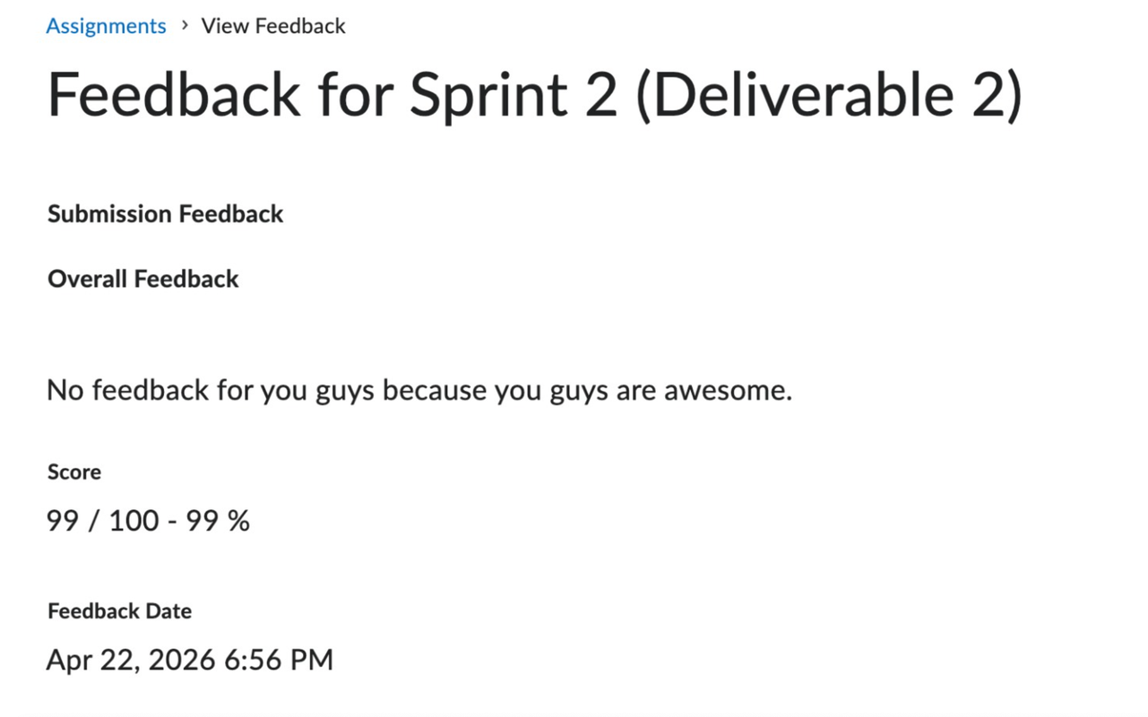
IMPROVEMENTS MADE FROM
PROFESSOR’S FEEDBACK
Notes:
Used a random sad man's picture to depict mental health, lmk if it works! if not, we can change it.

Slide 6
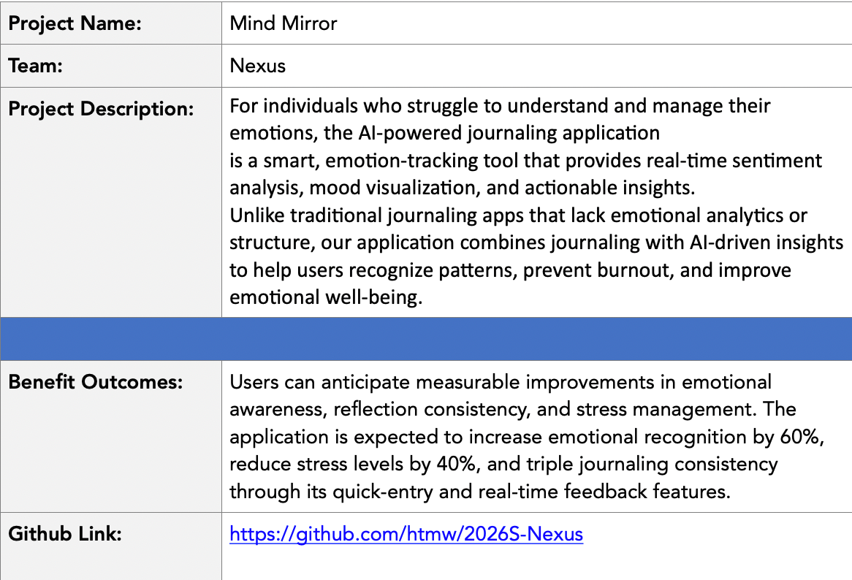

PROJECT DESCRIPTION
Team Nexus

Slide 7
COMMUNICATION PLAN
• Primary instant meeting platform: WhatsApp
• Video Meeting: Discord
Team members are expected to:
• Communicate respectfully and professionally
• Respond to messages within a reasonable time frame (ideally within 24 hours)
• Share progress updates, blockers, and concerns openly
• Use the agreed communication tools for all project-related discussions
TEAM WORKING AGREEMENT
MEETINGS & AVAILABILITY
The team will hold three regular sync meetings per week:
• Sunday: 10:00 AM • Tuesday: 6:30 PM • Thursday: 9:00 PM
Additional meetings may be scheduled as needed based on sprint requirements. Expectations:
• All members should attend scheduled meetings
• If unable to attend, members must notify the team in advance
• Meeting notes and action items will be documented and shared
Team Nexus

Slide 8
TASK MANAGEMENT
• Task tracking tool: Jira
All project tasks will be:
• Clearly defined and assigned
• Tracked through Jira
• Updated regularly to reflect progress
• Completed before agreed internal deadlines
TEAM WORKING AGREEMENT
CONFLICT RESOLUTION
In the event of conflict:
1. The concerned party should first express the issue to the team openly and respectfully
2. The team will attempt to resolve the issue collaboratively
3. If unresolved, the issue will be escalated to the Team Leader / Scrum Coordinator
4. Further escalation (e.g., to the instructor) will be considered only if necessary
Team Nexus

Slide 9
WORK EXPECTATIONS &
DEFINITION OF DONE
Each task is considered “Done” when:
• It meets the agreed acceptance criteria
• It is reviewed by at least one other team member (when applicable)
• Code runs without critical errors
• Relevant documentation is updated
• Changes are committed to the shared repository
Team members are responsible for:
• Completing assigned work on time
• Communicating blockers early
• Supporting teammates when needed
TEAM WORKING AGREEMENT
Team Nexus

Slide 10

NAME: SARAH MARTINEZ
STUDENT PERSONA
Age: 21
Gender: Female
Occupation: Undergraduate Computer Science Student
Sarah is a full-time college student balancing coursework, part-time work, and social commitments. During exam periods, her stress levels rise significantly, but she often ignores the early warning signs of burnout. She occasionally journals but finds long entries overwhelming and inconsistent. She wants a simple way to reflect daily without spending too much time.
Challenges:
Experiences fluctuating stress levels during the semester
Inconsistent journaling habits
Difficulty recognizing emotional patterns over time
Feels overwhelmed during midterms and finals
Goals:
Track emotional trends throughout the semester
Identify early signs of burnout
Receive short, actionable suggestions
Maintain better emotional balance during academic pressure

Slide 11

WORKING PROFESSIONAL PERSONA
NAME: DAVID CHEN
Age: 32
Gender: Male
Occupation: Software Engineer
David works remotely for a tech company and spends most of his day attending meetings and coding. While he performs well professionally, he often feels mentally drained without clearly understanding the cause. He values productivity and self-improvement but rarely pauses to reflect on his emotional state.
Challenges:
Blurred boundaries between work and personal life
Emotional fatigue during high-pressure deadlines
No structured way to monitor mood patterns
Limited time for long reflection exercises
Goals:
Understand how work stress affects his mood
Monitor emotional stability over time
Receive quick, data-driven insights
Improve work-life balance

Slide 12

WORKING PARENT PERSONA
NAME: EMILY PETERSON
Age: 40
Gender: Female
Occupation: HR Manager
Emiliy balances a demanding job with parenting responsibilities. Her schedule leaves little time for self-reflection, yet she recognizes the importance of emotional awareness. She often feels emotionally exhausted but cannot clearly identify triggers or patterns. She prefers simple, easy-to-use digital tools.
Challenges:
Limited time for lengthy journaling
Emotional fatigue from multitasking responsibilities
Difficulty identifying emotional triggers
Wants non-clinical, supportive guidance
Goals:
Build daily emotional awareness
Identify patterns in stress levels
Receive manageable well-being suggestions
Maintain emotional stability for herself and her family

Slide 13

SELF-IMPROVEMENT ENTHUSIAST PERSONA
NAME: ALEX RIVERA
Age: 27
Gender: Male
Occupation: Fitness Coach
Alex actively tracks his workouts, sleep cycles, and productivity habits. He believes emotional well-being is just as important as physical health but lacks a structured system to measure it. He is interested in data-driven insights and enjoys tools that provide analytics and visualizations.
Challenges:
Journaling apps provide no analytical insights
No measurable way to track emotional consistency
Wants deeper pattern recognition
Prefers technology-backed recommendations
Goals:
Quantify emotional trends
Compare mood ratings with AI sentiment analysis
Identify emotional volatility
Optimize overall mental performance

Slide 14
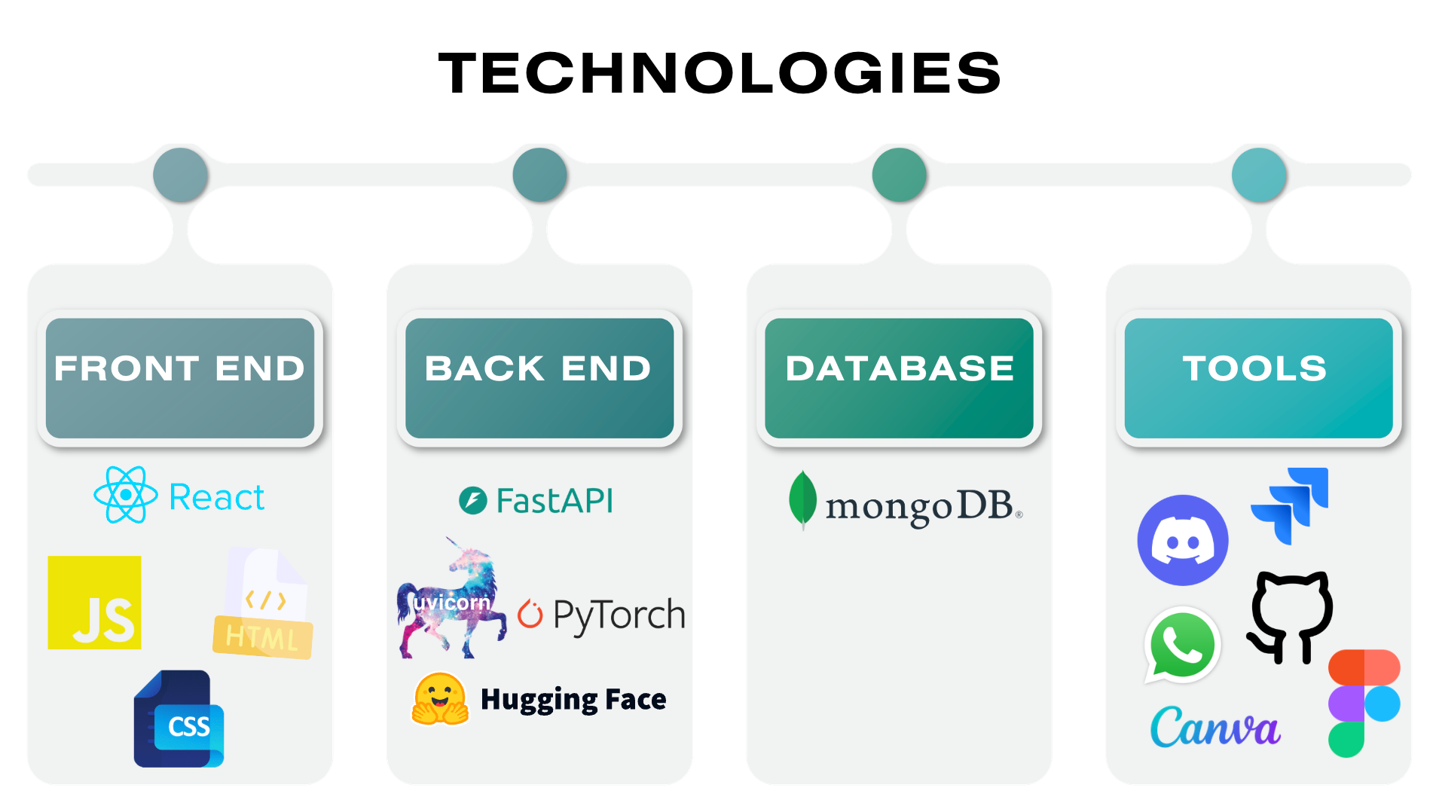

Slide 15
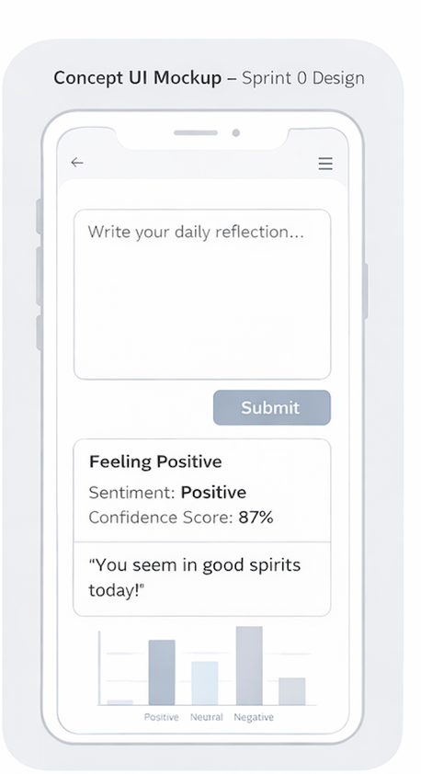
MINIMAL VIABLE PRODUCT (MVP)
An AI-powered journaling application with real-time emotional analysis and visual mood tracking.
Real-Time Sentiment Analysis – Journal entries are analyzed instantly using an NLP model.
Mood Classification System – Each entry is labeled as Positive, Neutral, or Negative.
Confidence Score Display – Shows the model’s certainty level for each classification.
Immediate Mood Feedback – Provides short, supportive emotional insights after analysis
Visual Mood Distribution – Displays a basic chart showing mood trends over time.
Local Entry Persistence – Saves journal entries locally for later review (MVP scope).
Team Nexus

Slide 16

COMPONENTS
● Journal Input Manager : Handles user journal entry input and submission through the web interface.
● Backend API Manager : Manages HTTP requests and communication between frontend, sentiment model, and database.
● Sentiment Analysis Manager : Processes journal text and classifies sentiment (Positive / Neutral / Negative).
● Confidence Scoring Module: Extracts prediction probability scores from the DistilBERT output.
● Mood Feedback Generator: Converts sentiment results into short, supportive emotional insights.
● Data Persistence Layer : Stores journal entries, sentiment labels, confidence scores, and timestamps.
● Mood Visualization Manager: Retrieves stored data and generates mood distribution charts over time.
Team Nexus

Slide 17
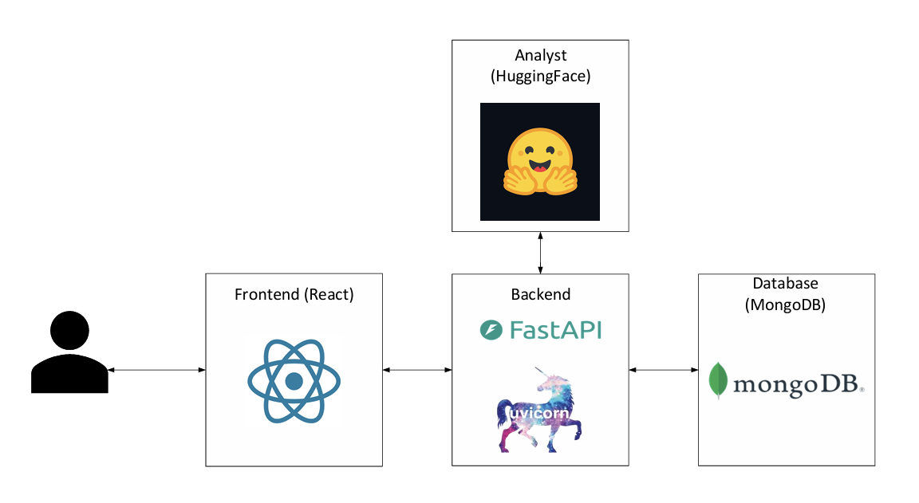
ARCHITECTURE
DIAGRAM
Team Nexus

Slide 18
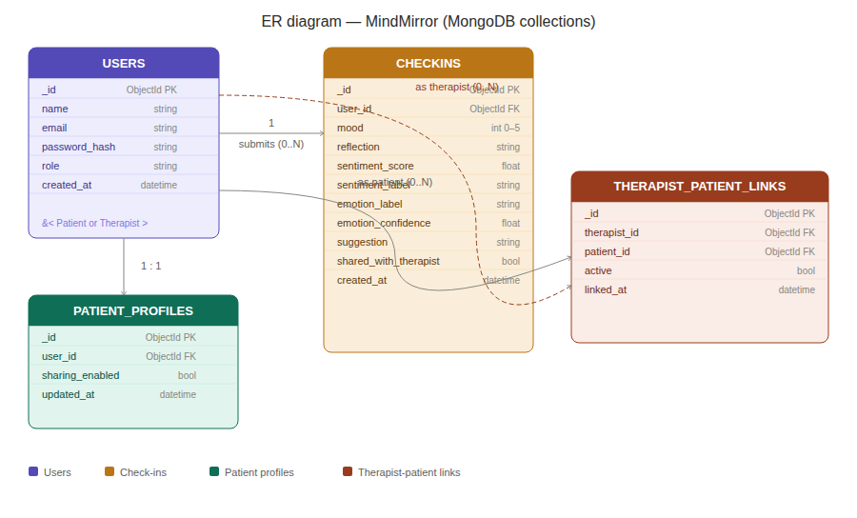
ER DIAGRAM
Team Nexus

Slide 19
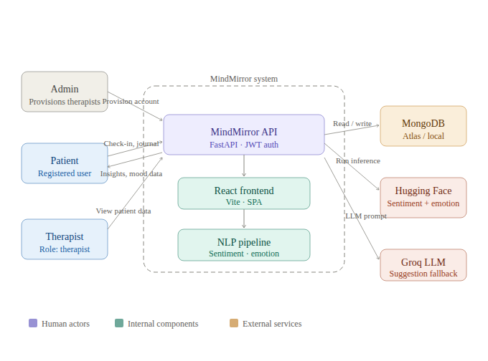
CONTEXT
DIAGRAM
Team Nexus

Slide 20
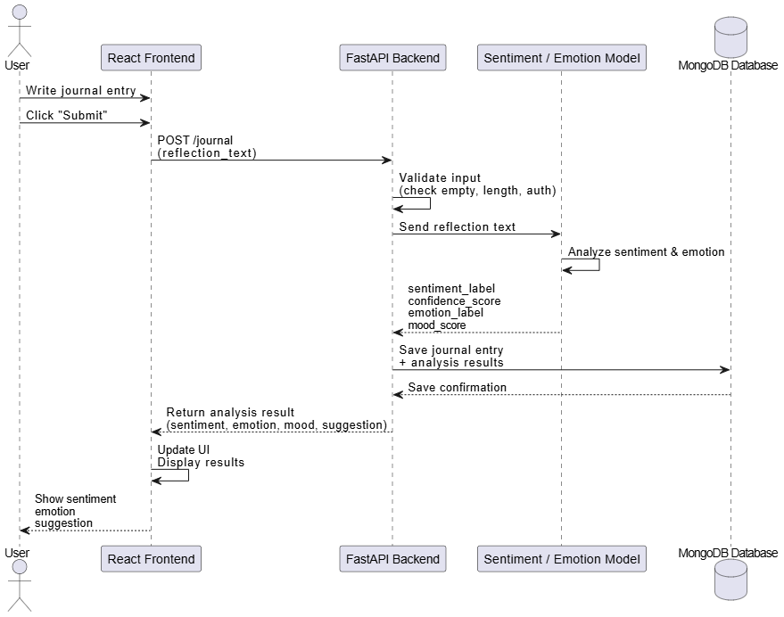
SEQUENCE DIAGRAM
-JOURNAL ENTRY
Team Nexus

Slide 21
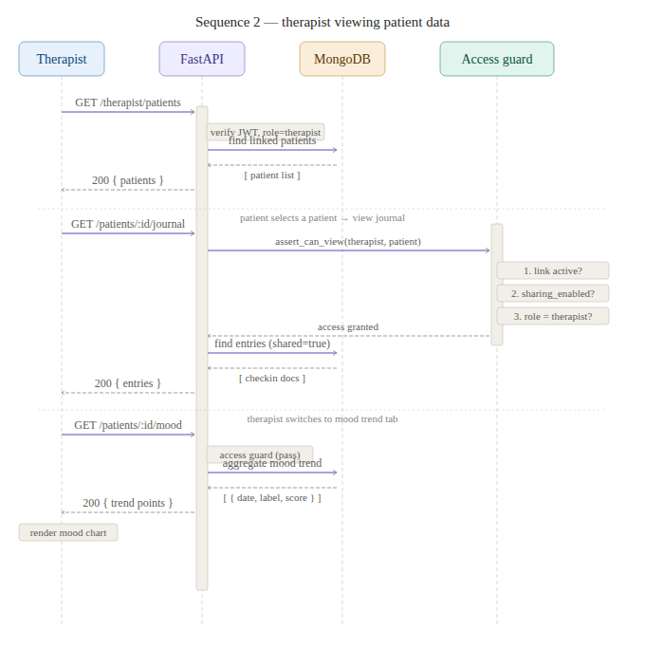
SEQUENCE DIAGRAM
-THERAPIST
Team Nexus

Slide 22
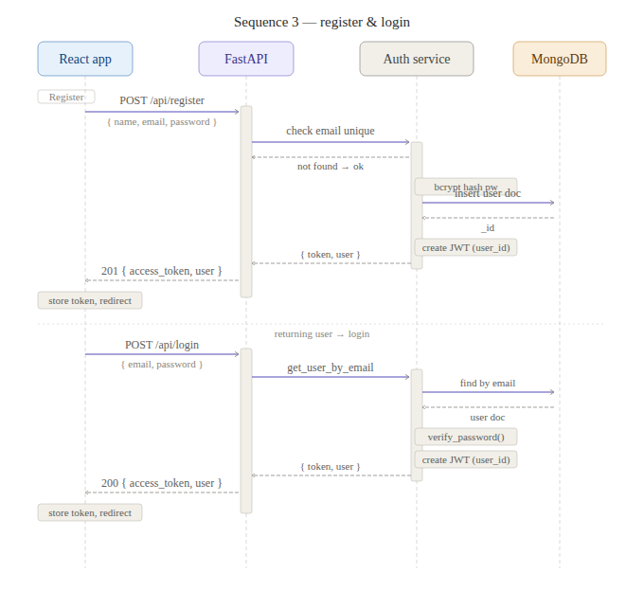
SEQUENCE DIAGRAM
-AUTH
Team Nexus

Slide 23
SPRINT 2 RECAP
What We Set Out To Do
What We Delivered
Deliver a usable authenticated patient flow with sign up, sign in, protected routes, and logout.
Implemented signup, login, JWT auth, auth headers, protected routes, and logout flow.
Extend the app beyond submission into Past Entries, Insights, and mood-over-time support.
Added Past Entries UI, Insights API support, mood history support, and updated mood chart behavior.
Store sentiment results on entries so mood history and charting use persisted data.
Integrated therapist-facing data access and patient-view groundwork on the integration branch.
Improve UX reliability with better loading states, safer error handling, and protected APIs.
Added global backend error handling, frontend API interception, toast alerts, and graceful ML failure fallback.
Team Nexus

Slide 24
PRODUCT BACKLOG
THERAPIST
ACCESS &
SHARING
US20 – Therapist Journal Access
As a user, I want my therapist to have access to my journal and mood data so that they can better understand my emotional state.
Acceptance Criteria
System supports linking a user to a therapist account
Therapist role exists in the system
Therapist can access user data
US21 – Enable Journal Sharing
As a user, I want to enable sharing of my journal and mood data so that my therapist can access it.
Acceptance Criteria
A "Share toggle is visible in user settings
When toggled ON: sharing state saved in backend
Therapist gains access to journal + mood data
US22 – Disable Sharing
As a user, I want to disable sharing at any time so that I can revoke my therapist's access.
Acceptance Criteria
User can toggle sharing OFF at any time
Backend updates immediately
Therapist loses access instantly
Previously visible data is no longer accessible
Priority: Must Story Points: 5
Priority: Must Story Points: 8
Priority: Could Story Points: 5
THERAPIST
DASHBOARD
US23 – View Assigned Users
As a therapist, I want to see my assigned users so that I can access their shared data.
Acceptance Criteria
Therapist dashboard displays a list of assigned users
Each user shows basic identifier
Only users linked to that therapist are shown
US24 – View User Journal & Mood
As a therapist, I want to view journal entries and mood trends of users who have enabled sharing so that I can understand their emotional patterns.
Acceptance Criteria
Therapist can view journal entries in chronological order
Mood trends shown as chart or list
Data is shown only if sharing is ON
Priority: Could Story Points: 5
Priority: Could Story Points: 5
Detailed spreadsheet here

Slide 25
SPRINT 1 SUMMARY
Sprint Name: Sprint 1
Sprint Duration: February 20th - March 26th *
Sprint Length: 1 month *
Sprint Goal: This sprint focused on delivering a functional journaling workflow that allows users to submit journal entries and begin sentiment analysis processing.
Stories Committed: US1, US2, US3, US4, US5, US6, US7, US8, US9, US10, US13
Total Story Points Committed: 41
Detailed spreadsheet here
Team Nexus

Slide 26
SPRINT 2 SUMMARY
Sprint Name: Sprint 2
Sprint Duration: April 3rd - April 16th
Sprint Length: 2 weeks
Sprint Goal: This sprint focused on incorporating users into the system by implementing secure registration, login, and authenticated access to journal features.
Stories Committed: US6, US11, US12, US13, US15, US16, US17, US18, US19.
Total Story Points Committed: 40
Detailed spreadsheet here
Team Nexus

Slide 27
SPRINT 3 BACKLOG
Sprint Name: Sprint 3
Sprint Duration: April 17th - May 15th
Sprint Length: 3 weeks
Sprint Goal: This sprint focuses on enabling secure, user-controlled sharing of journal and mood data between users and their therapists, including the ability to grant and revoke access at any time.
Stories Committed: US20, US21, US22, US23, US24
Total Story Points Committed: 28
Detailed spreadsheet here
Team Nexus

Slide 28
SPRINT 3 TASK BREAKDOWN
Sprint 3 focused on therapist sharing workflows. User stories were broken into smaller technical tasks so ownership, implementation effort, and dependencies could be tracked clearly across backend, frontend, and integration work.
Why Task Breakdown Mattered
Clarified who owned each part of therapist linking, sharing, and read-only data access.
Separated backend API work from frontend workflow and UI tasks.
Made it easier to track which therapist-sharing stories were complete versus still in progress.
Supported parallel work on access control, dashboard views, sharing toggles, and patient detail flows.
Detailed spreadsheet here
Team Nexus

Slide 29
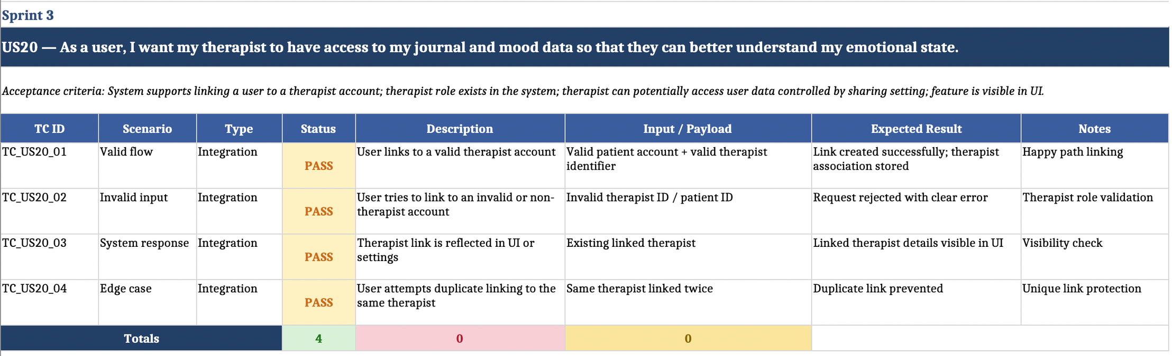
SPRINT 3 TEST CASE
Detailed spreadsheet here

Slide 30
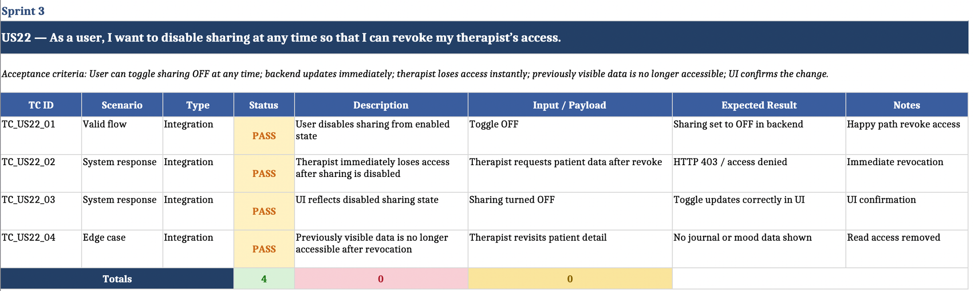
SPRINT 3 TEST CASE
Detailed spreadsheet here

Slide 31
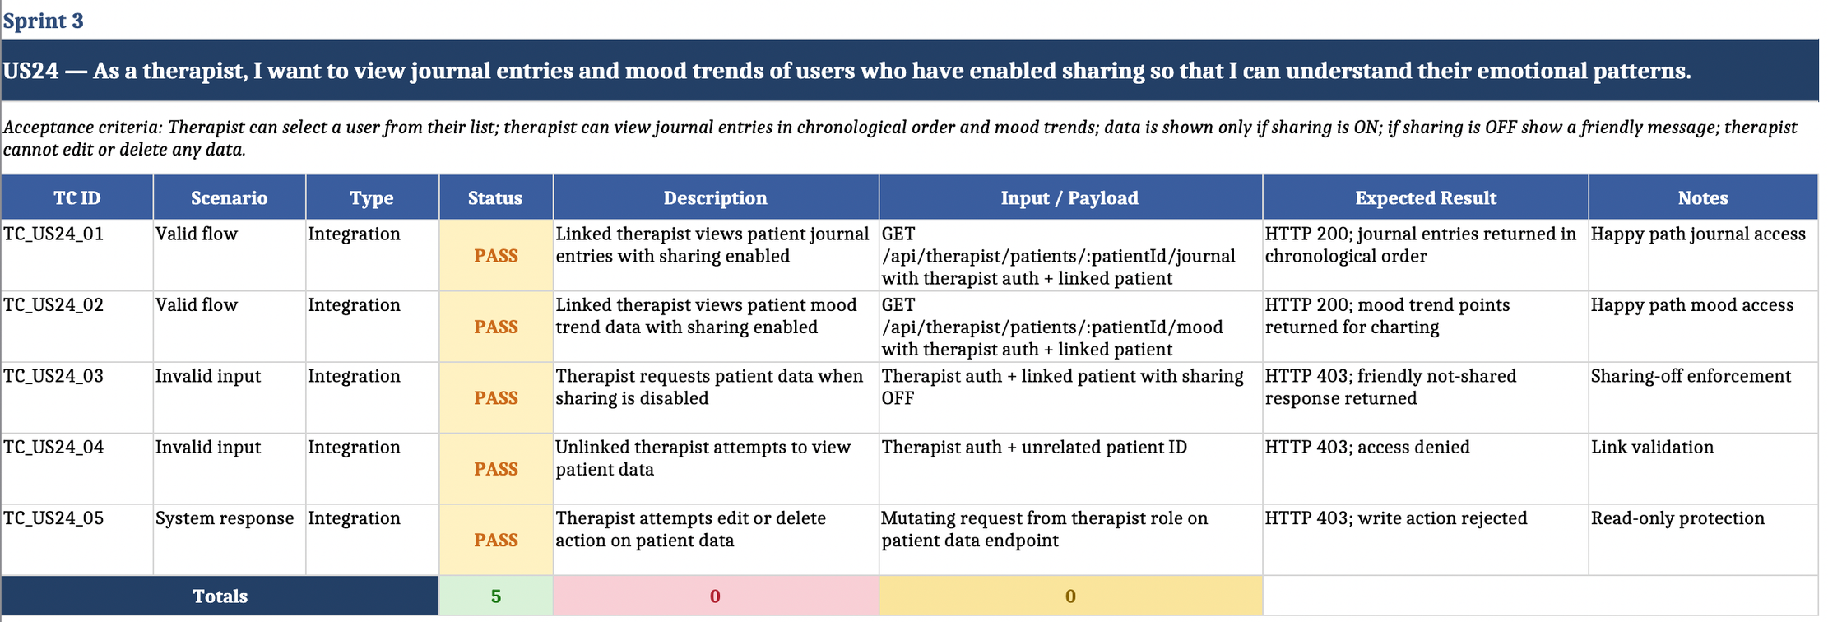
SPRINT 3 TEST CASE
Detailed spreadsheet here

Slide 32
SPRINT 3 TEST CASE SUMMARY
Sprint 3 centered on therapist-sharing workflows, revoking access, and therapist-side visibility into shared patient data.
Sprint Focus
Expand the product beyond individual patient use into therapist-linked access and controlled data sharing.
Support secure enable/disable sharing flows so patients control when therapists can access their data.
Add therapist-facing views for assigned users, journal history, and mood trends while keeping the experience read-only.
Prepare process deliverables alongside implementation work, including retrospective, planning, technical paper, and user manual.

Slide 33


SPRINT 3 STORIES COMPLETED
US20 Therapist access setup and therapist-linked workflow support
US22 Disable sharing and revoke therapist access immediately
Therapist journal and mood-trend viewing with sharing and read-only protection
Detailed spreadsheet here
Team Nexus

Slide 34
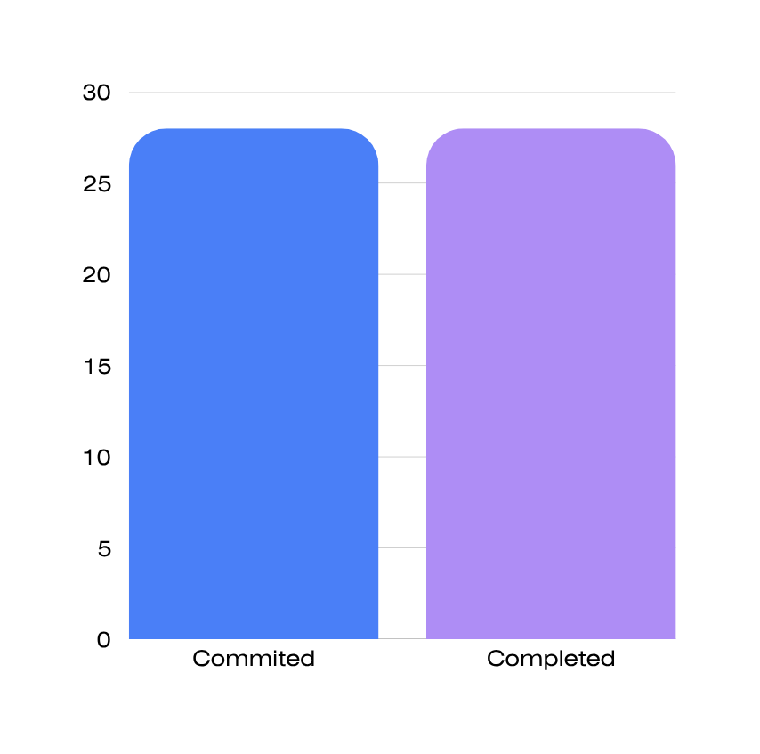
METRICS
Team Velocity
Team estimated points | 28
Team points delivered | 28
Total points carried over | 28
Team Velocity | 100%
Team Nexus

Slide 35
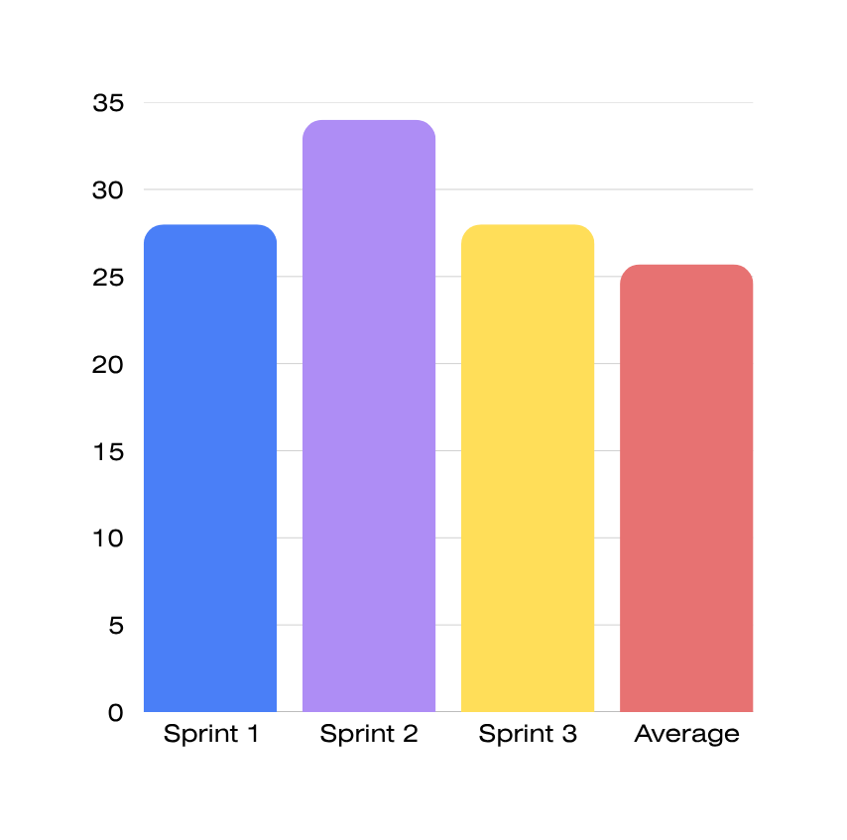
METRICS AVERAGE
Team Velocity
Total velocity of sprint 1:
Total velocity of sprint 2:
Total velocity of sprint 3:
28
34
15
Average:
25.7
Team Nexus

Slide 36
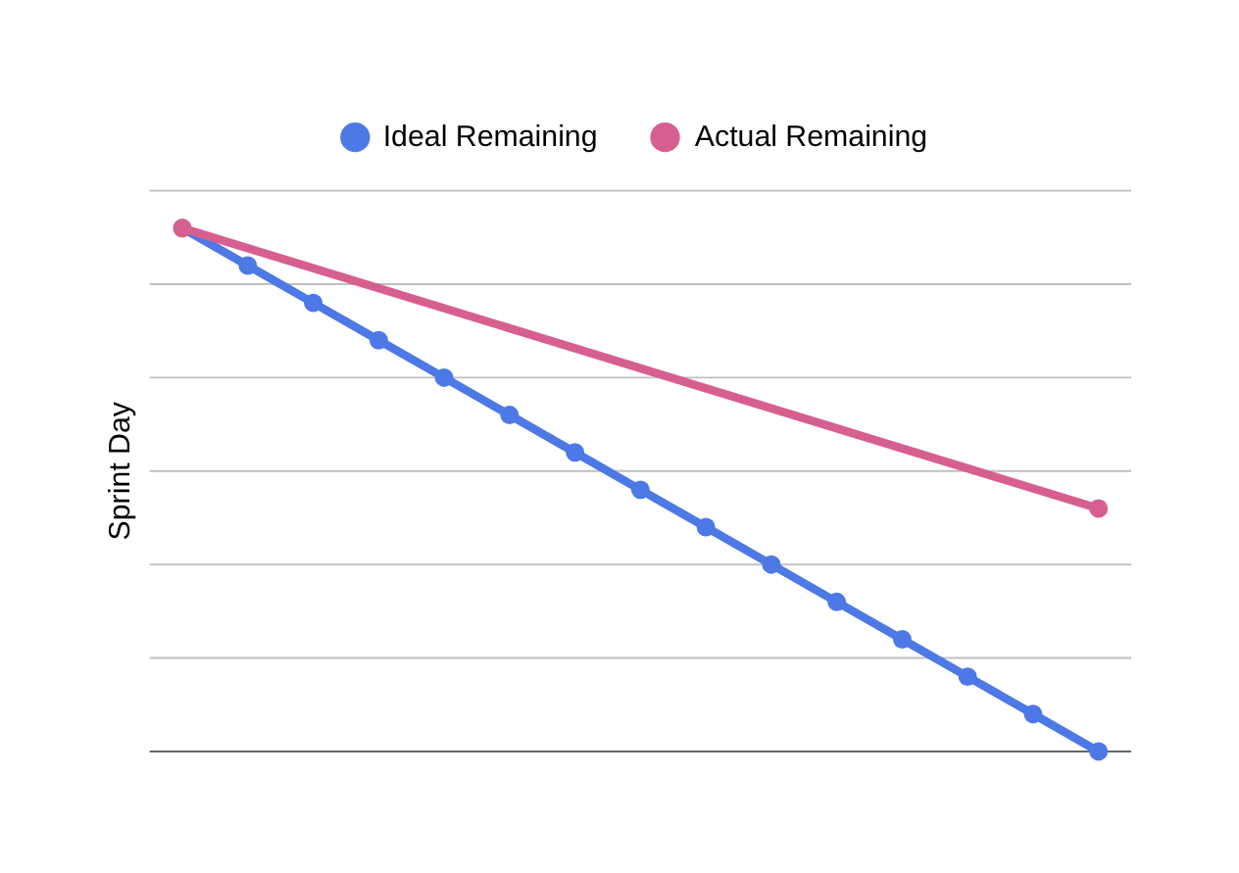
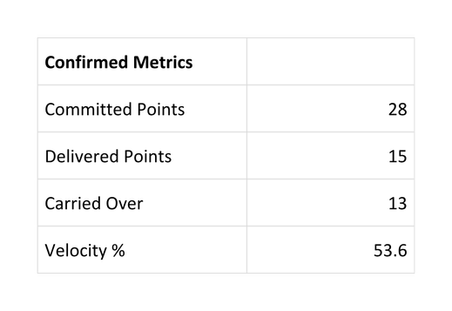
BURNDOWN STATUS
Team Nexus

Slide 37
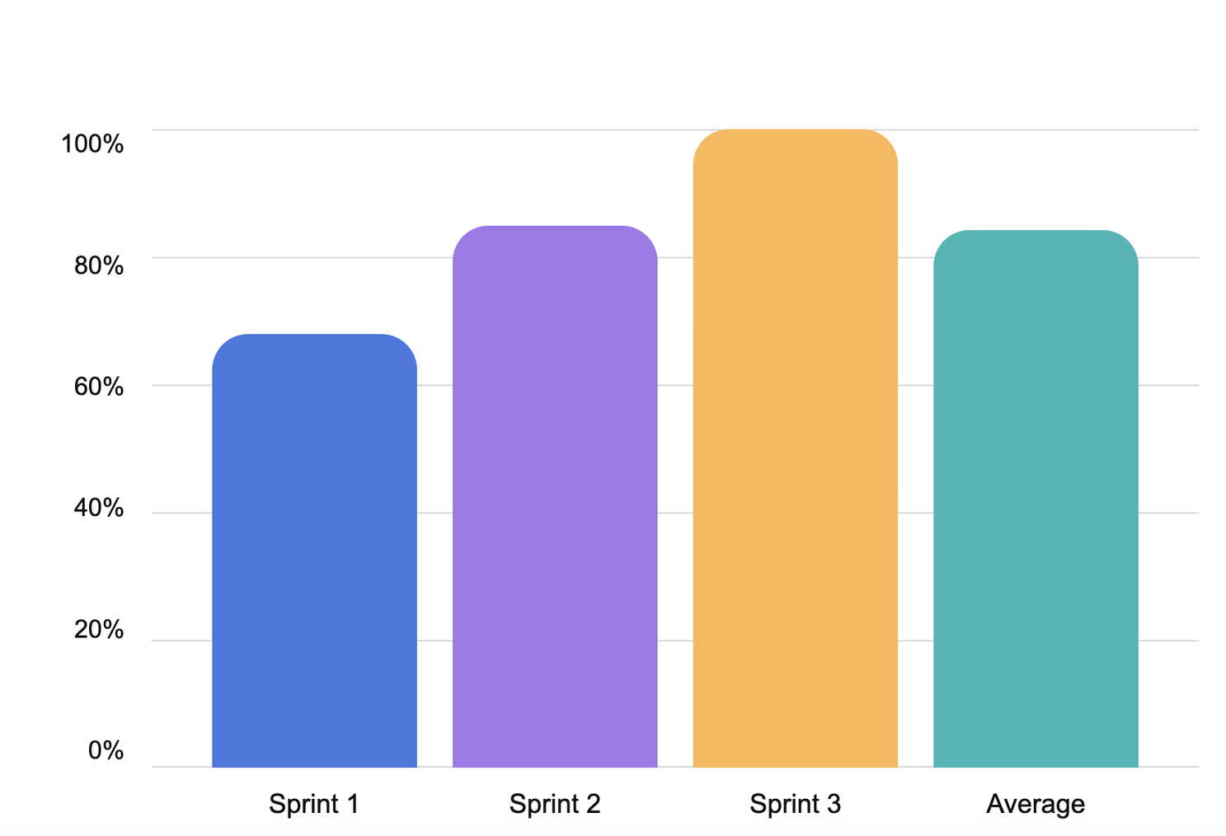
COMPLETED VS COMMITTED
Sprint 1
Committed: 41
Completed: 28
Ratio: 68%
Sprint 2
Committed: 40
Completed: 34
Ratio: 85%
Sprint 3
Committed: 28
Completed: 28
Ratio: 100%
Team Nexus

Slide 38
RETROSPECTIVE
WHAT WENT WELL
CHALLENGES
Earlier start on documentation and
slides
Ticket statuses weren't always kept up to
date on the board
Better collaboration between co-owners
on shared tasks
Workload wasn't always evenly distributed
across the team
Team members supported each other
when blocked
Team Nexus

Slide 39
WIKI PAGE LINK

Slide 40
DEMO

Slide 41
THANK YOU
15 May, 2026

